Slide 1
The IMPACT of Understanding the Whole Child
Saltburn Primary School

Slide 2
School Context
Saltburn-by-the-Sea is a small Victorian seaside town on the North East coast with a mixed catchment area. (Professional families to areas of high deprivation.)
Saltburn Primary is based within a new purpose built Learning Campus which includes the secondary school, Huntcliff.
We are a large Primary School, a two form intake of 420 pupils and a 39 place nursery.
22% Free School Meals, this is an increasing trend.
SEND 8%

Slide 3
What ImpacT?
Progress is up from 12 APS to 14.5 in Key stage 2.
Reduced gap in attainment between FSM and non FSM.
Two levels progress up from 78% to 94%.
% of children on track for two levels progress or more in Key Stage 2, years 3, 4 and 5, is up from an average of 68% to 94%.
% of children achieving Level 2 is up from 78% to 100% in KS1.
% of children achieving expected level in Y1 phonics test - 74%.
UFS children made significant progress from their starting points with a 5% rise in children achieving 78 points at end of UFS and a significant reduction between the median and bottom from 20 to17.2%.This is well below the local authority average of 29%.

Slide 4
Knowledge of the Child
Data through high quality assessment with very well trained staff.
Social/ Home/ Environmental knowledge
Strengths and weaknesses.
What makes them tick?

Slide 5
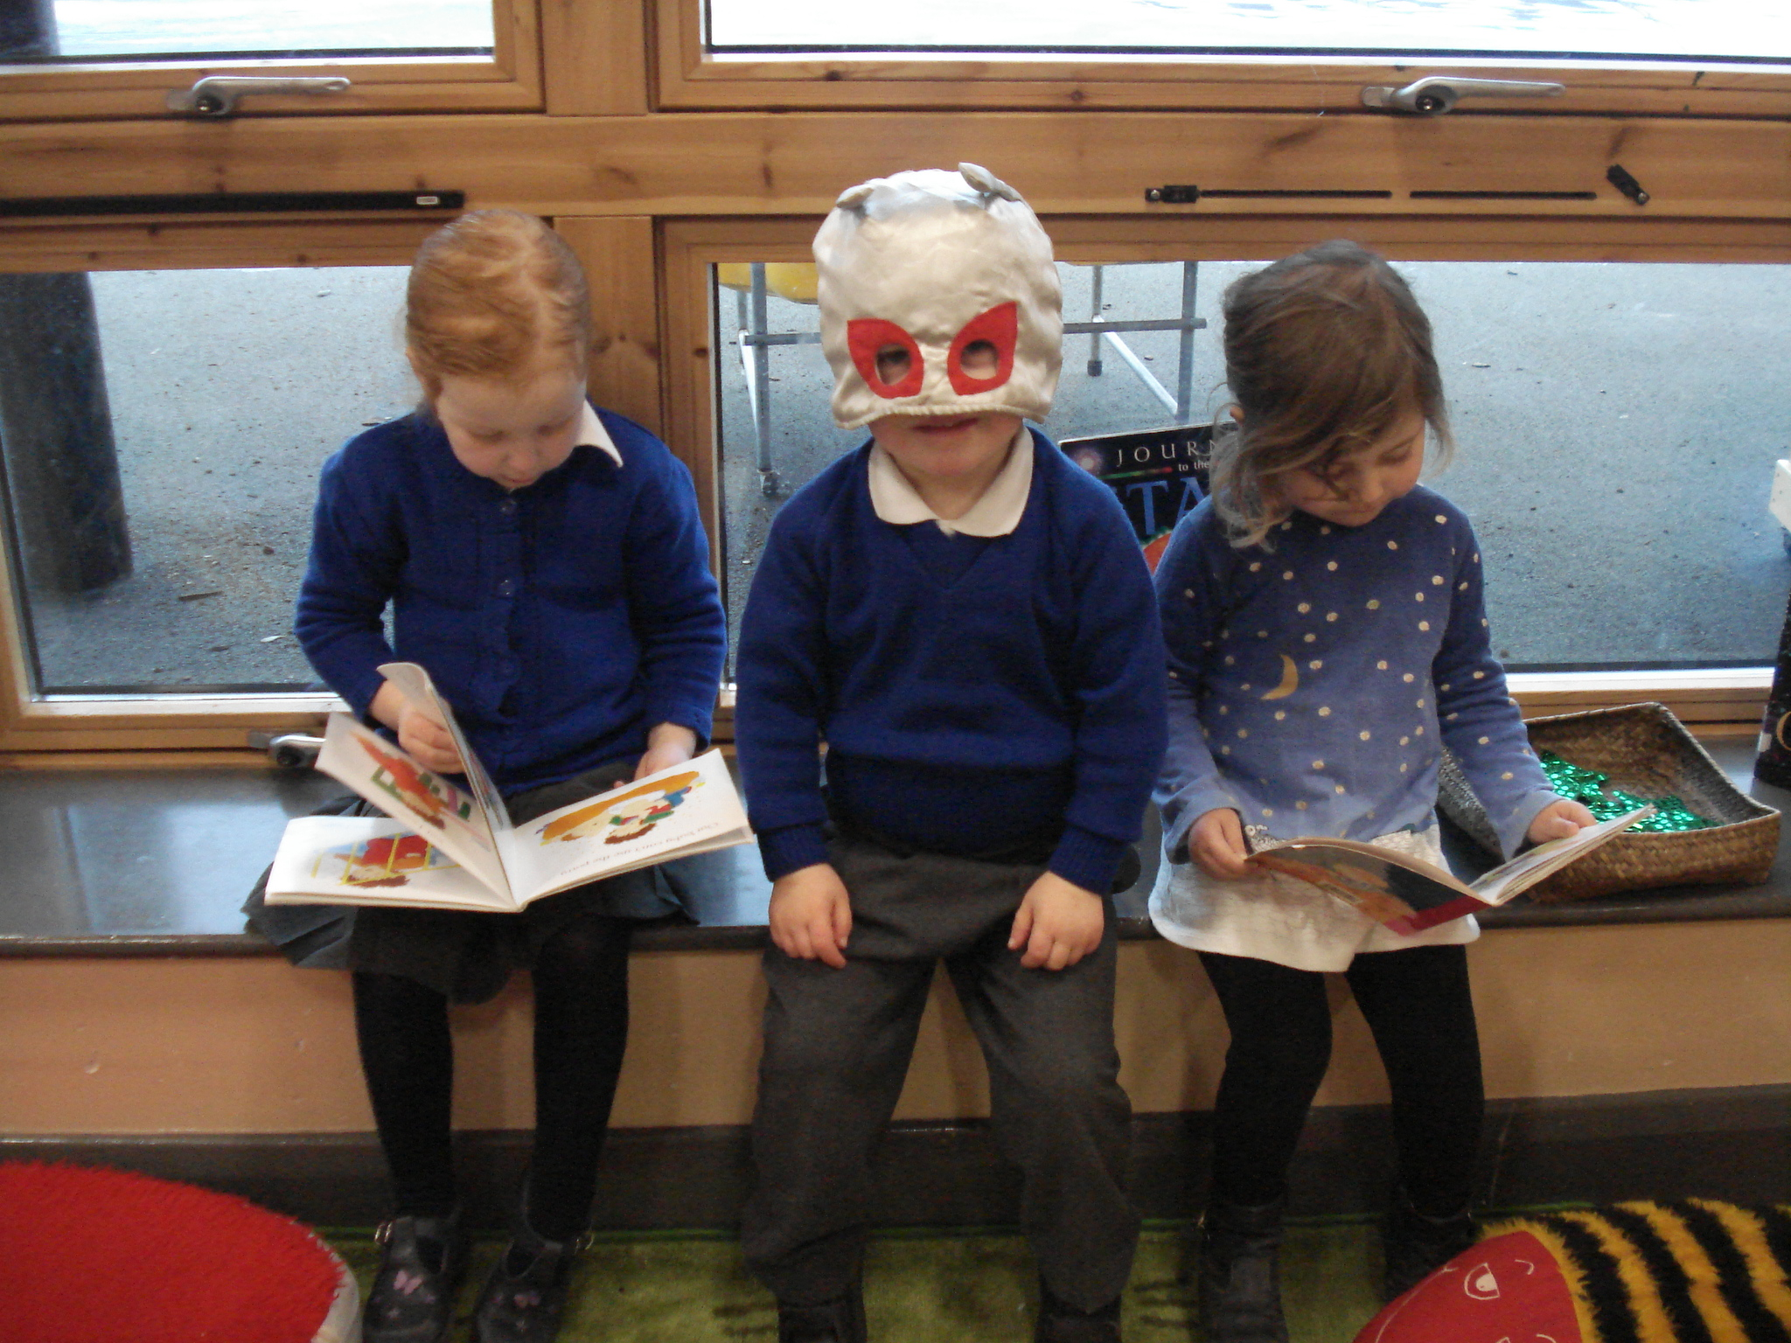

Slide 6
How does this have Impact?
Pupil Progress
Curriculum design

Slide 7
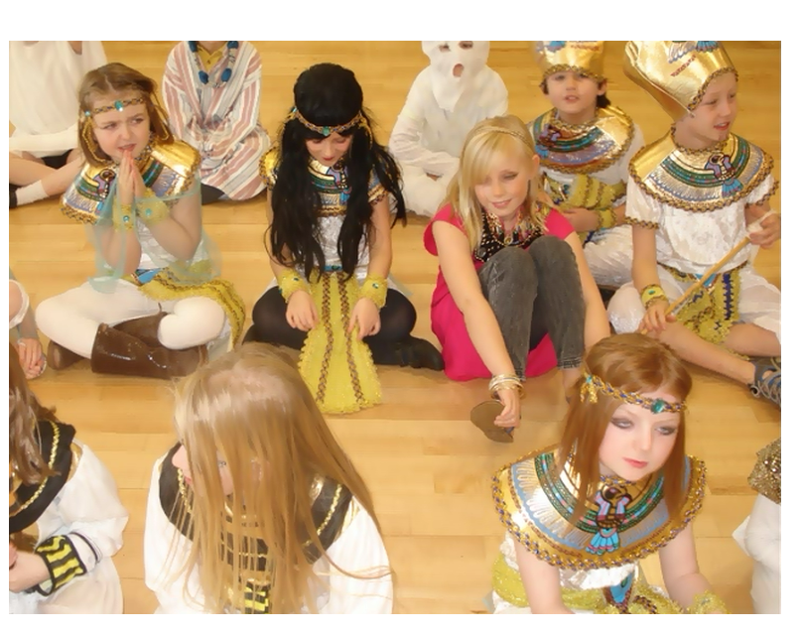
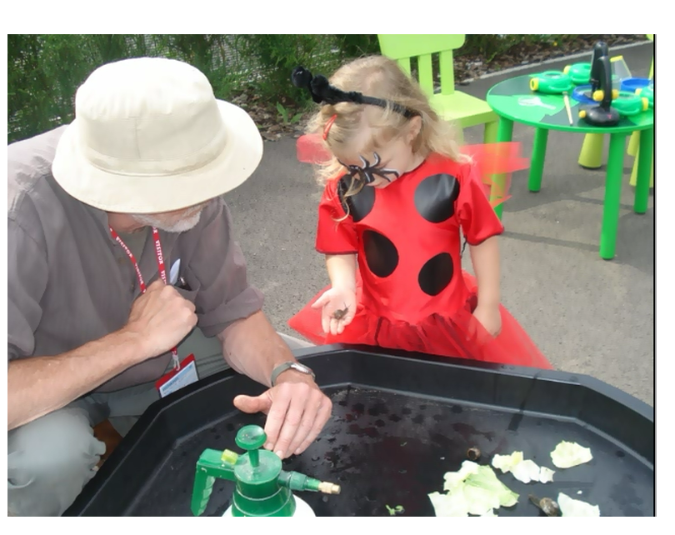
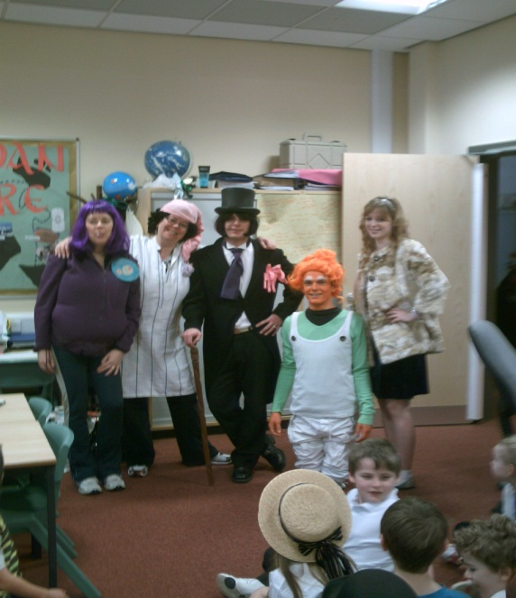
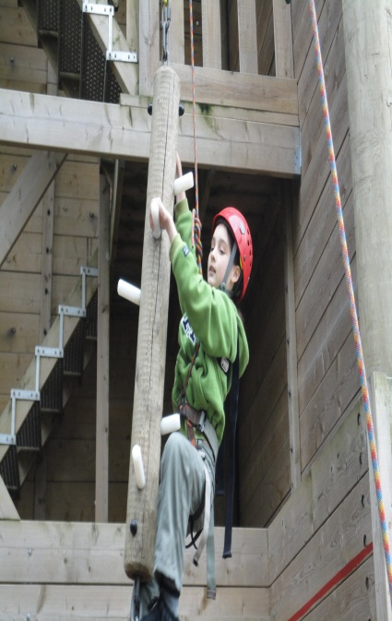
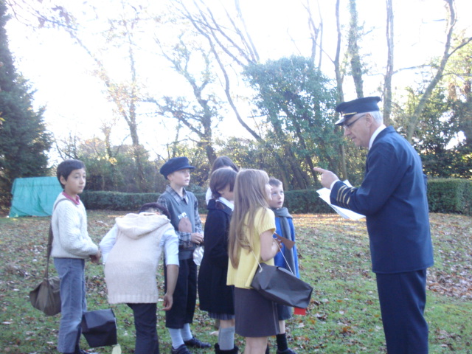
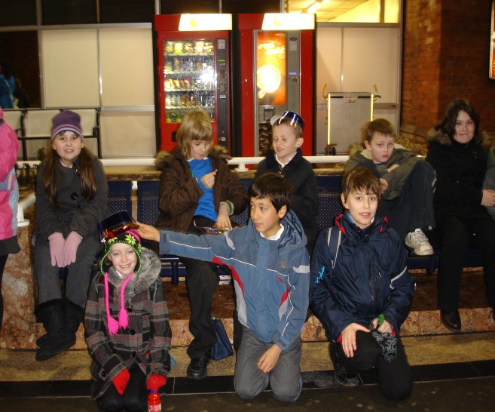
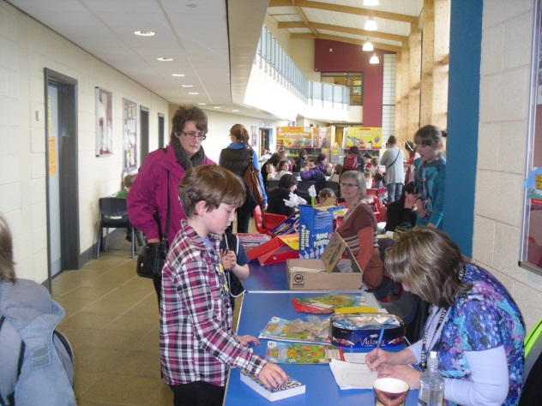
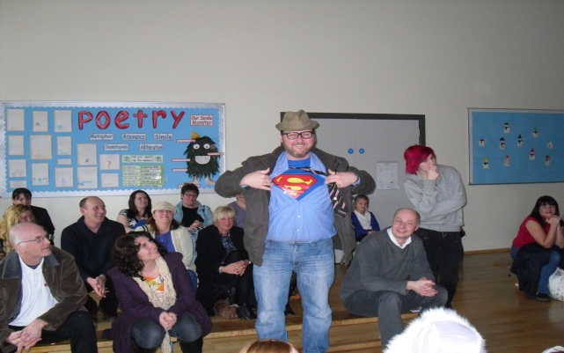
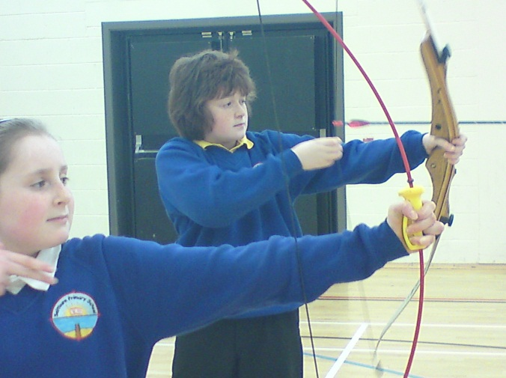
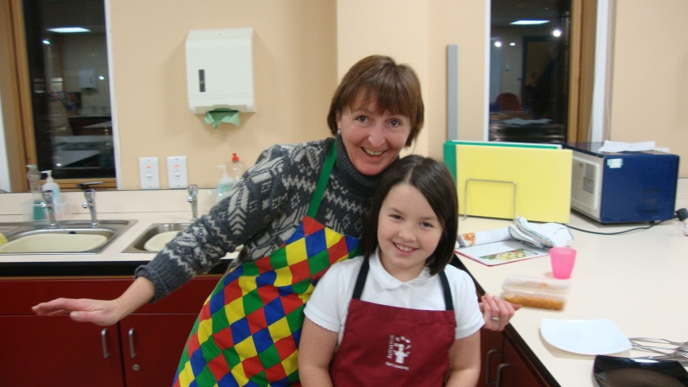

Slide 8
How does this have Impact?
Engagement of pupils.
Engagement of family.
Engagement of community.
Transition, from Foundation all the way to Key Stage 3.
Learning Walks

Slide 9
What are you ALREADY DOING TO UNDERSTAND THE WHOLE CHILD? Can you think of ONE THING YOU Could DO TO IMPROVE UNDERSTANDING OF THE WHOLE CHILD IN YOUR SCHOOL?

