Slide 1
Let’s Demystify Progress 8
A simple and practical introduction to the new Progress 8 measures aimed at those who are not specialists in the education sector.
Michelle Ellams

Slide 2
Headline measures
Progress 8
Ebacc entry
Ebacc achievement
English & Maths (at a strong pass)
Destinations

Slide 3
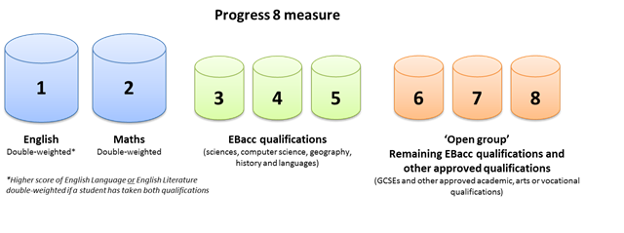
Progress 8 is the performance of students in 8 different subjects
Subjects are categorised into 3 buckets;
The points are calculated to give the student’s Attainment 8 score
Every student will have an Expected score based on KS2 performance
The total score is measured against this to give the Progress 8 score

Slide 4
Lets have a go at calculating some Progress 8 Scores

Slide 5
• A score of zero means pupils in this school on average do about as well at key stage 4 as other pupils across England who got similar results at the end of key stage 2
• A score above zero means pupils made more progress, on average, than pupils across England who got similar results at the end of key stage 2
• A score below zero means pupils made less progress, on average, than pupils across England who got similar results at the end of key stage 2

Slide 6
Summary
English Literature and Language must both be studied to get the double weighting
Double weight the best of the English (lit or lan) & Maths
Identify the best 3 subjects in bucket 2 for ebacc
Identify the best 3 subjects in bucket 3 (including vocational subjects)
Compare this with expected attainment
Divide by 10 to give their P8 scores

Slide 7
Progress 8 would be better if…

Slide 8
What are the issues?
DfE Descriptor
Table: ASCL 2017

Slide 9
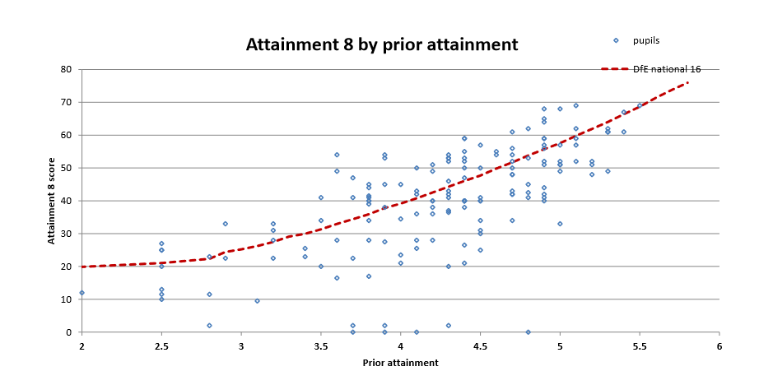
What are the issues?
Graph: ASCL 2017

Slide 10
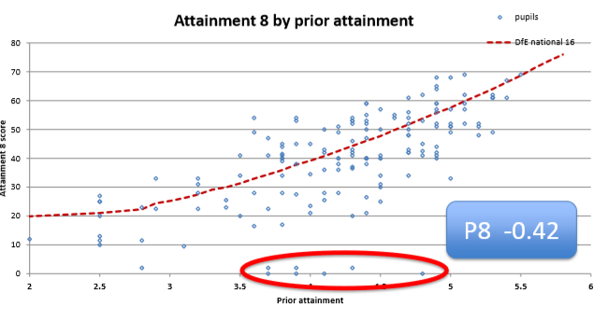
Graph: ASCL 2017

Slide 11
Intervention focus must be across all subjects to maximise point scores
High Quality resource; consistent approach across 21 subjects
Forensic level of content mapping for the specifications
Support for teachers to enhance planning; learning and teaching
Independent learning - students can learn anywhere; anytime
Automated intervention to identify gaps in knowledge and independent learning
Assignment feature can demonstrate impact of usage
Visual user analysis reports & bespoke reports

Slide 12
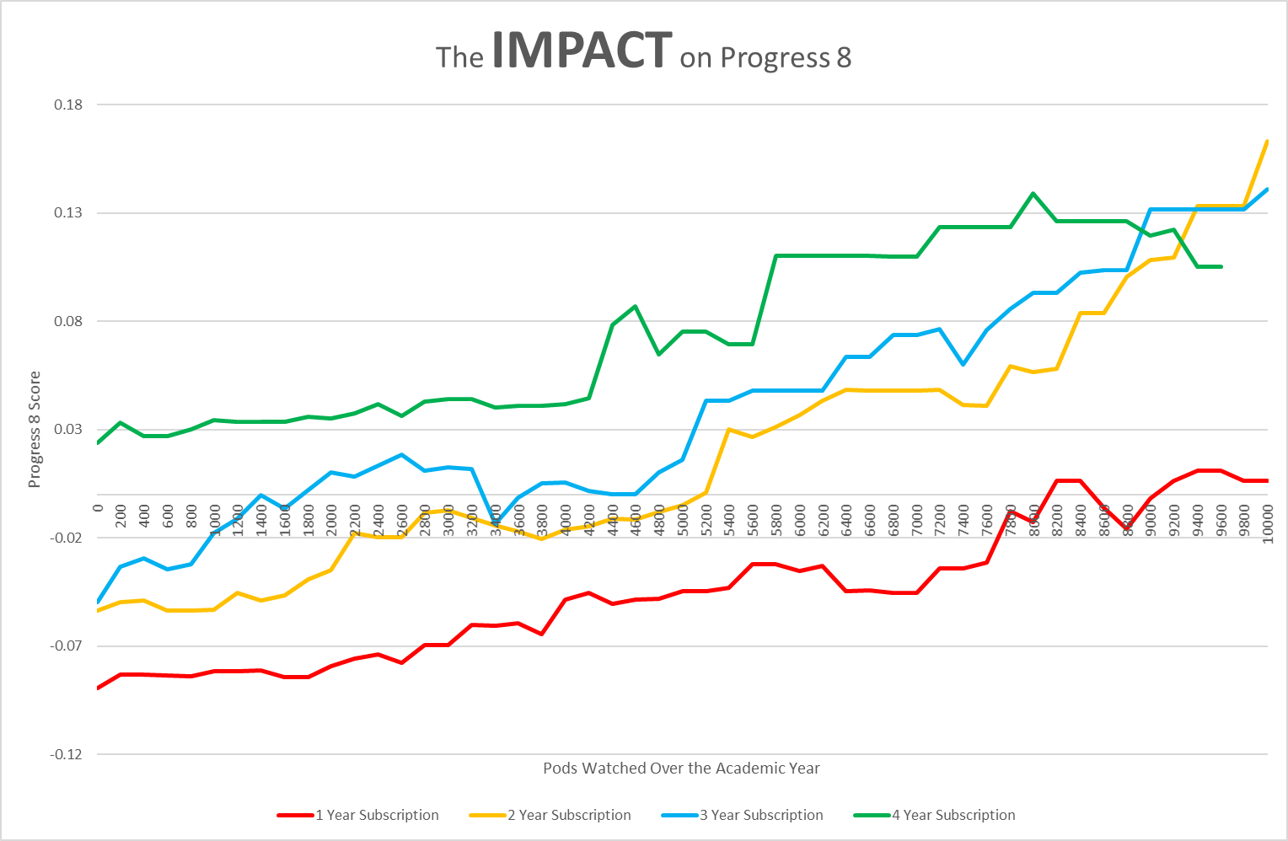

Slide 14
Impact
‘What an impact – Having recently analysed the year 11 leavers GCSE performance against their use of GCSEPod, there is phenomenal evidence to show a clear correlation between their academic progress and the time they spent on GCSEPod; the average Progress 8 score for the top 10 users of GCSEPod was +0.95 (with a range of +0.43 to +1.74). Almost a whole grade higher than that expected in every subject studied. WOW’
Mr David Pohl, Yardleys School

Slide 16
Hope it helped….
Leadership Specialist
Michelle Ellams
07951 790 319
michelle.ellams@gcsepod.com

